Slide 1
blocksize
2025-04-12 tysons

Slide 2
Why you should care
The feasibility of (much) larger blocks

Slide 3
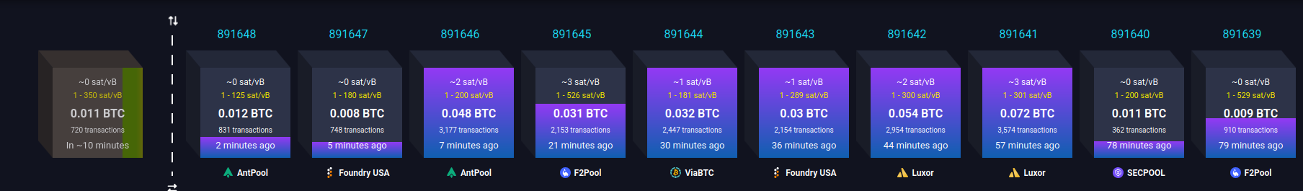
Why care?

Slide 4
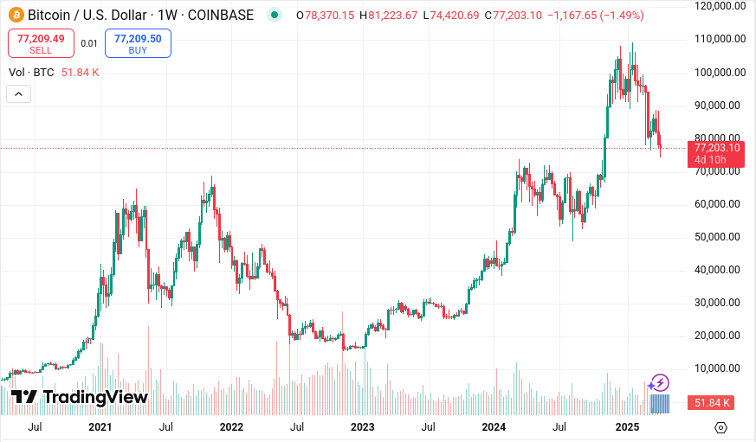
Why care?

Slide 5
Why care?
“well, I can still transact”

Slide 6
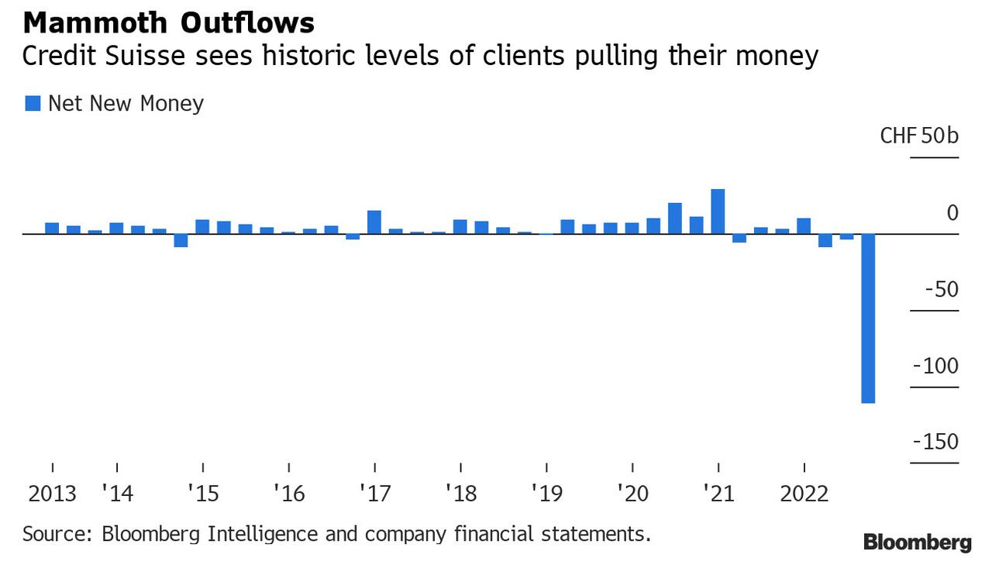
Finance is discontinuous

Slide 7
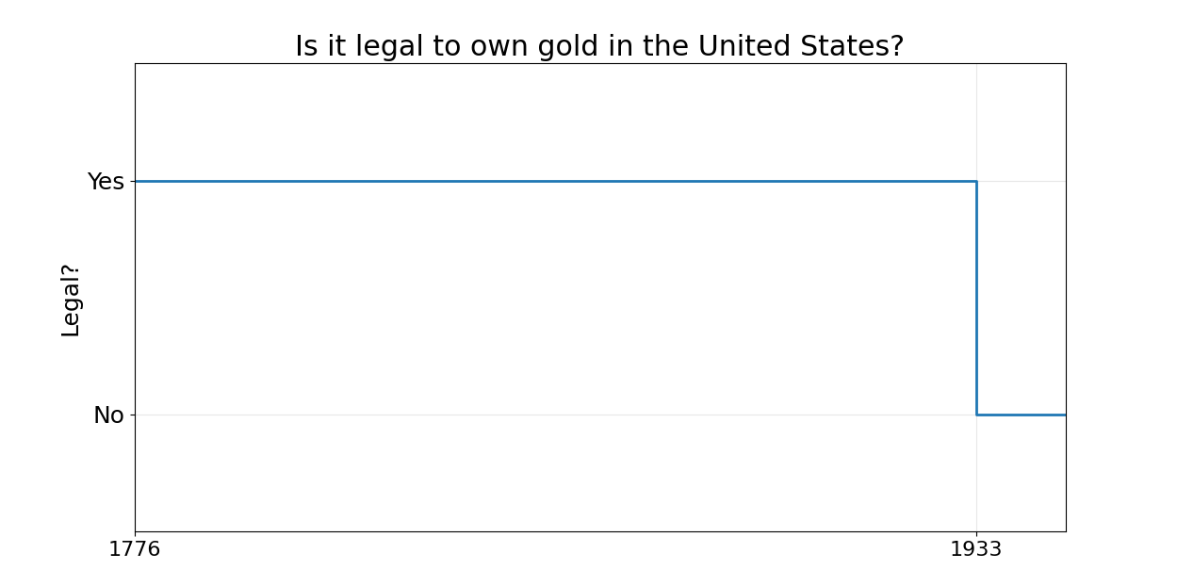
Finance is discontinuous
regulation

Slide 8
“Consider a turkey that is fed every day. Every single feeding will firm up the bird’s belief that it is the general rule of life to be fed every day by friendly members of the human race.
On the afternoon of the Wednesday before Thanksgiving, something unexpected will happen to the turkey. It will incur a revision of belief.”
Nassim Taleb (ardent bitcoin supporter)

Slide 9
not your keys,
not your coins consensus

Slide 10


Slide 11
all of the sudden
everyone wants to be a self-custodian
now what?

Slide 12
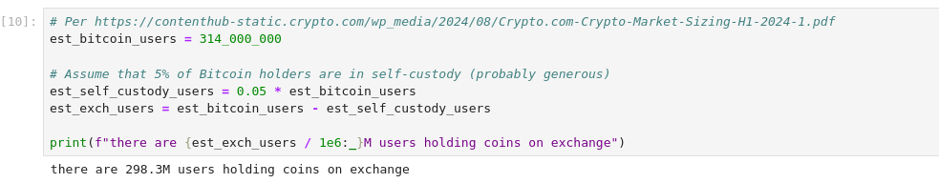
chain limitations on exit

Slide 13
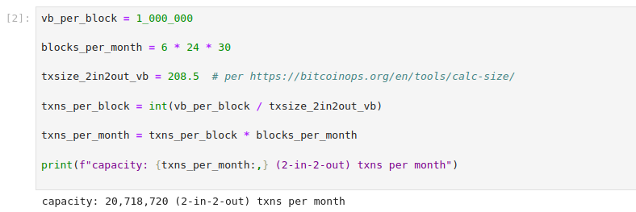
chain limitations on exit

Slide 14
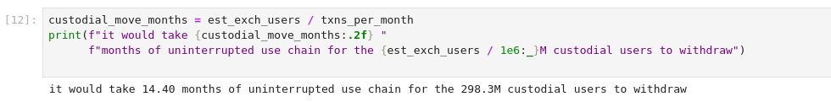
chain limitations on exit

Slide 15
US gov (or G7 countries) 6102 an impl. w/ forks
“Exit window” given
Blackrock has fork choice in their S1, dumps other side
Profit-seeking (and regulated) miners must follow
“Real” bitcoin PoW cooked

Slide 16


US gov (or G7 countries) 6102 an impl. w/ forks
“Exit window” given
Blackrock has fork choice in their S1, dumps other side
Profit-seeking (and regulated) miners must follow
“Real” bitcoin PoW cooked

Slide 17
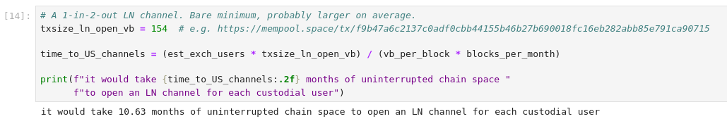
existing L2s don’t solve

Slide 18
best-case response
some kind of batched withdrawal to “other” L2s
Ark, Lightning, cashu, fedimint
some TBD shared UTXO scheme
you don’t have real bitcoin, but you escaped gov?
exchanges need preexisting batch connections

Slide 19
best-case response
some kind of batched withdrawal to “other” L2s
Ark, Lightning, cashu, fedimint
some TBD shared UTXO scheme
you don’t have real bitcoin, but you escaped gov?
exchanges need preexisting batch connections
without L1 access, you can always get rugged

Slide 20
objections

Slide 21
fee revenue for miners
“miners will need high fees and
full blocks to get paid”

Slide 22
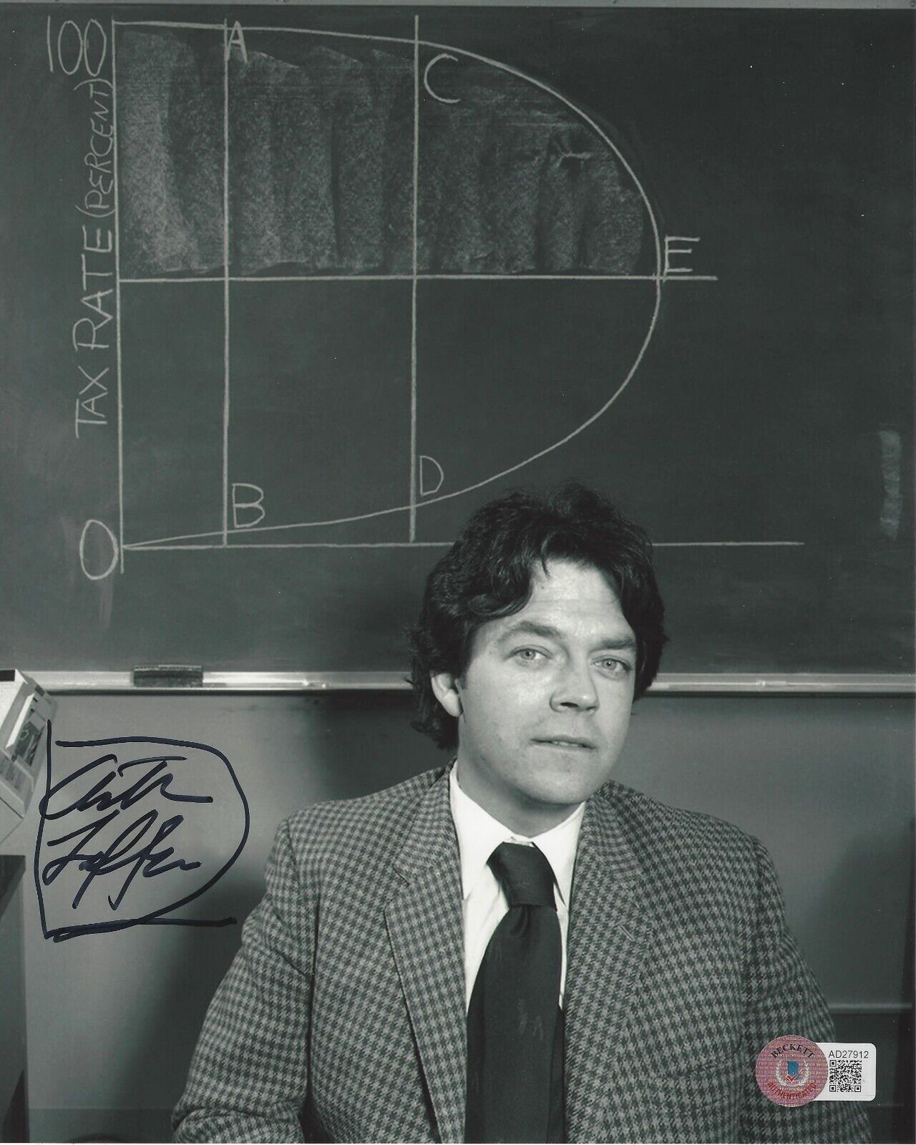

Slide 23
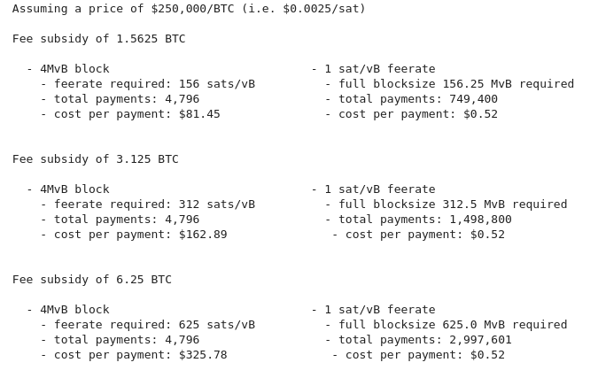
fee revenue for miners

Slide 24
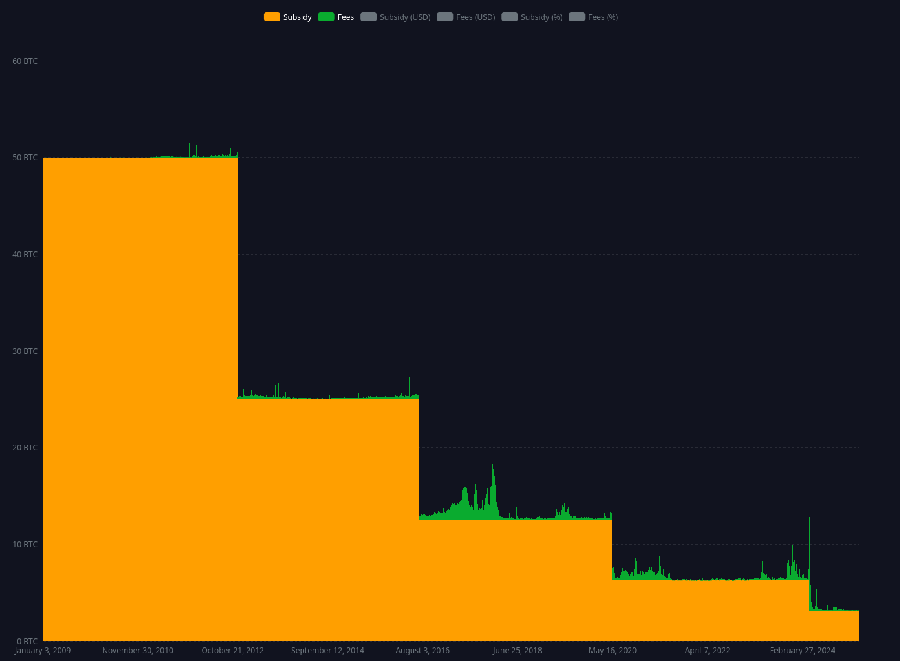
fee revenue for miners

Slide 25
makes IBD harder
“how ever will I sync?”

Slide 26
makes IBD harder
easy problem to solve
assumeutxo is already sufficient
to tip in under ~2 hours on most computers
assumevalid already in use by default
maybe someday
swiftsync
zerosync

Slide 27
makes tip maintenance harder
“how will my node stay current?”

Slide 28
brief measurement digression
Performed on “pretty good” consumer desktop
Directionally true to anything with SSD, >32GB RAM

Slide 29
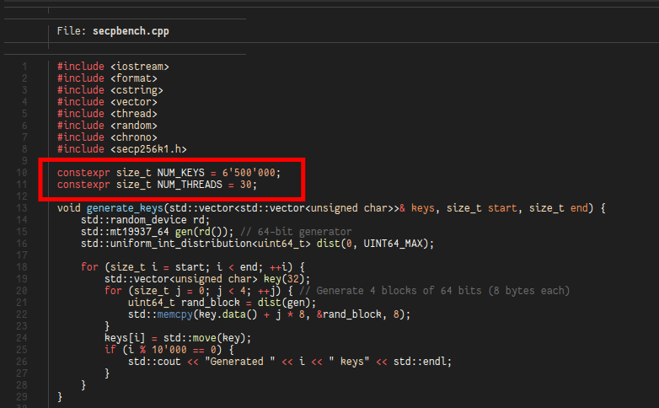
checking sigs

Slide 30
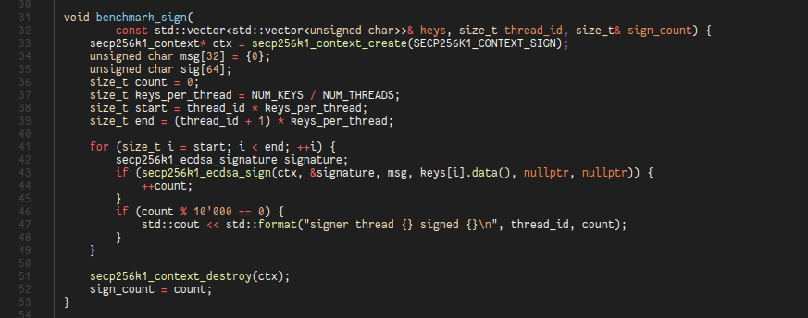
checking sigs

Slide 31

checking sigs
???

Slide 32
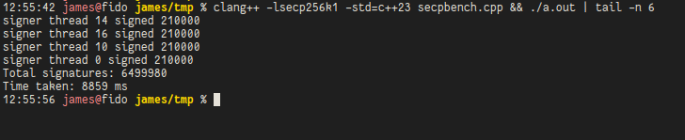
checking sigs
???

Slide 33
brief measurement digression
P2P as the event loop: TX, CMPCTBLOCK, BLOCKTXN, ...
There are basically two files in Core for perf:
validation.cpp
net_processing.cpp
Script caching: cached on mempool acceptance
UTXO set cache warming

Slide 34
work distribution
???

Slide 35
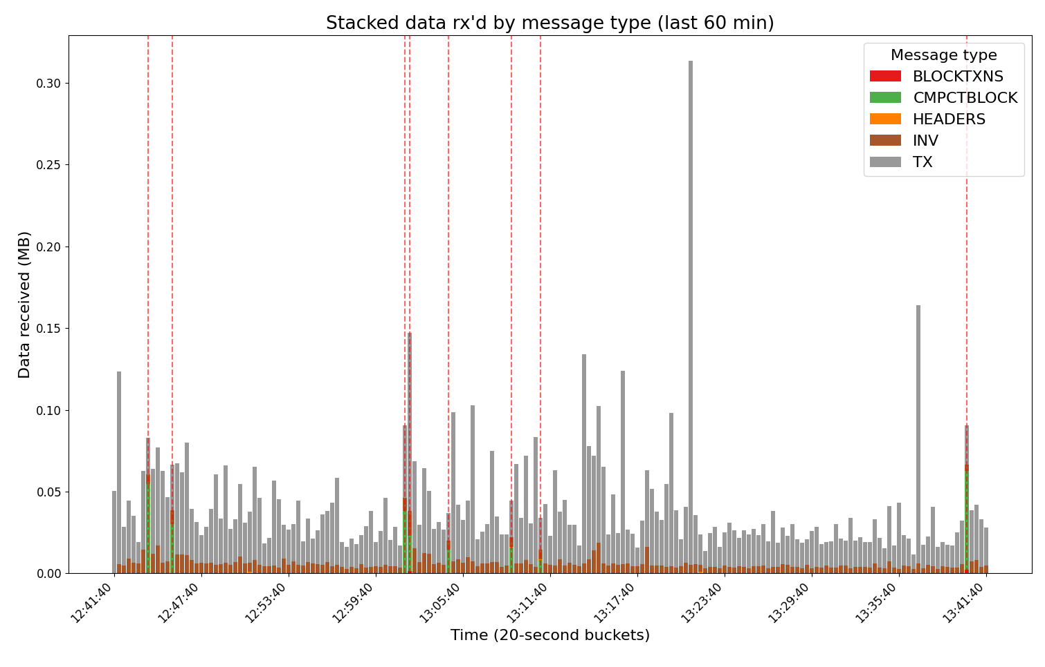
measurement: distribution of data rx’d

Slide 36
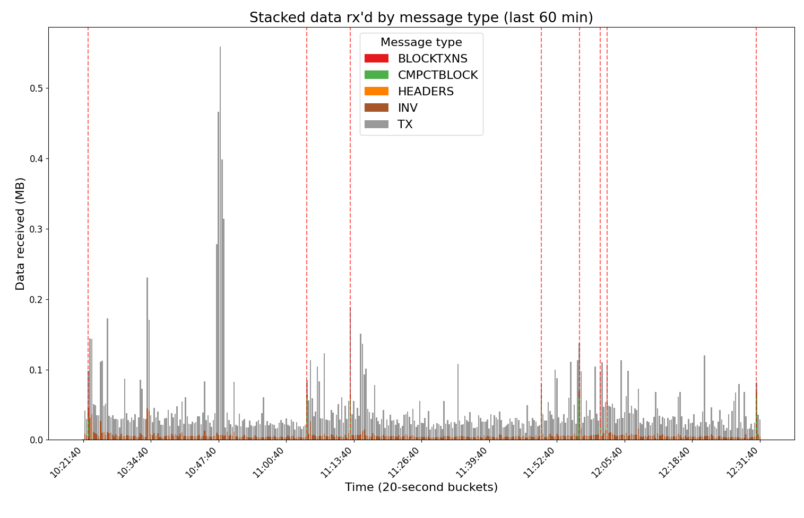
measurement: distribution of data rx’d

Slide 37
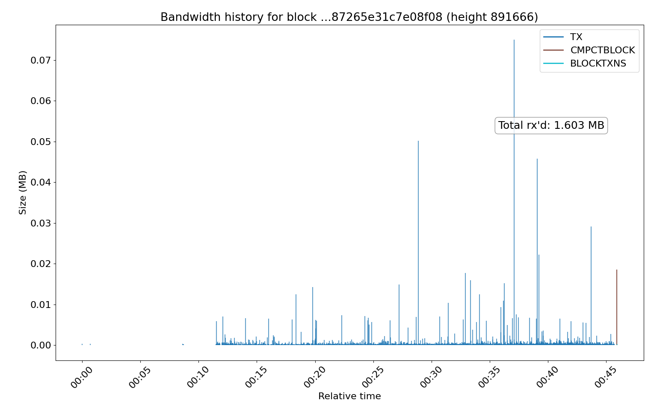
measurement: block bandwidth history

Slide 38
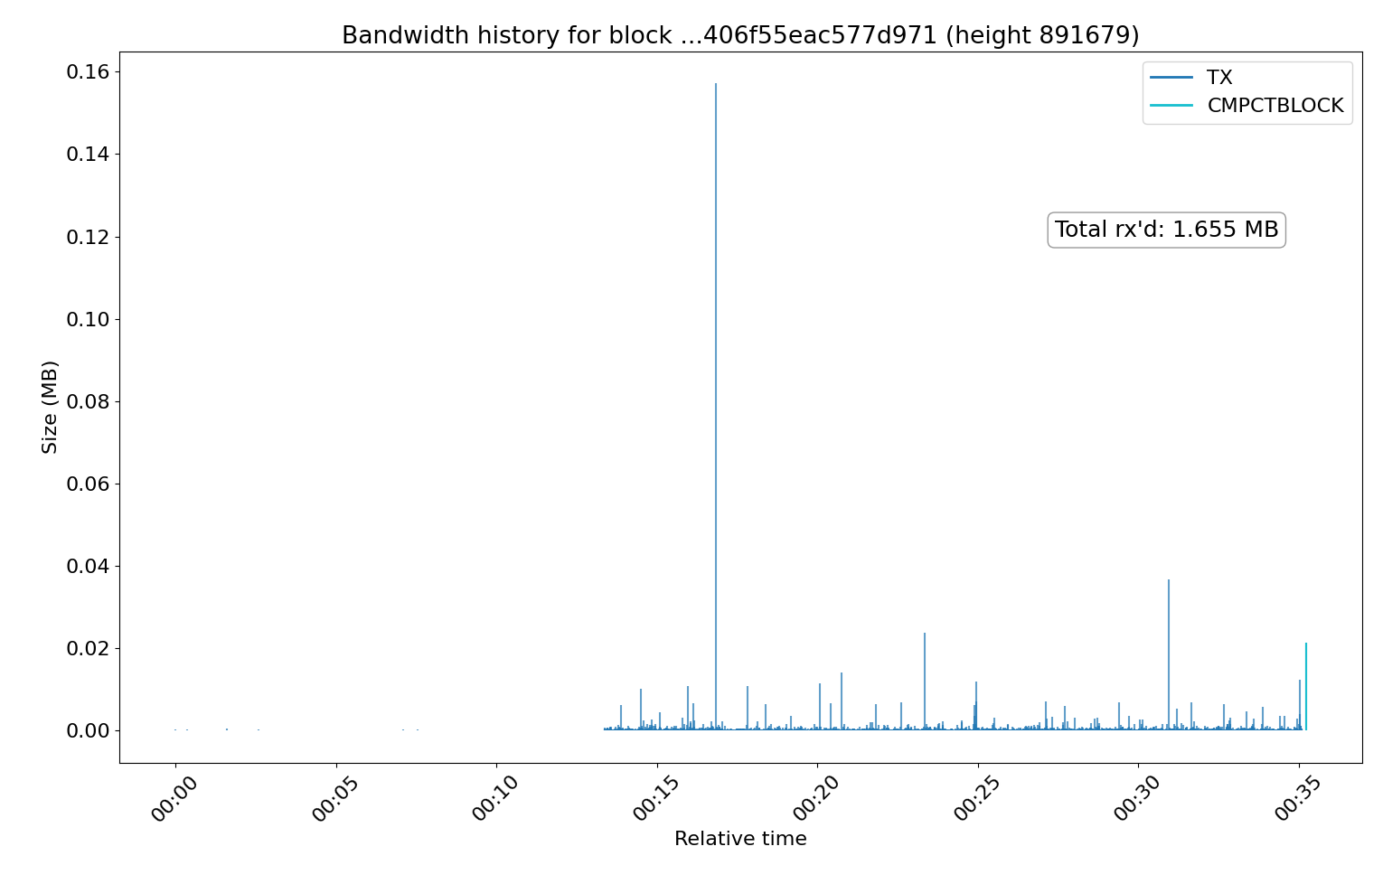
measurement: block bandwidth history

Slide 39
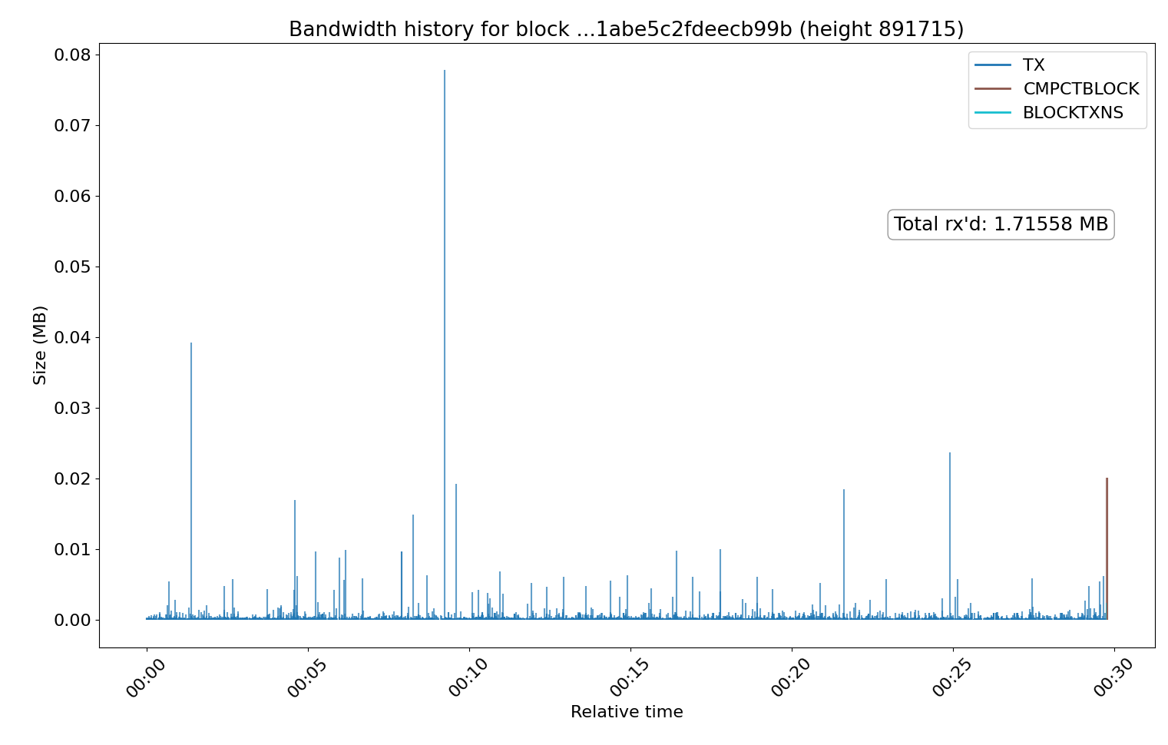
measurement: block bandwidth history

Slide 40
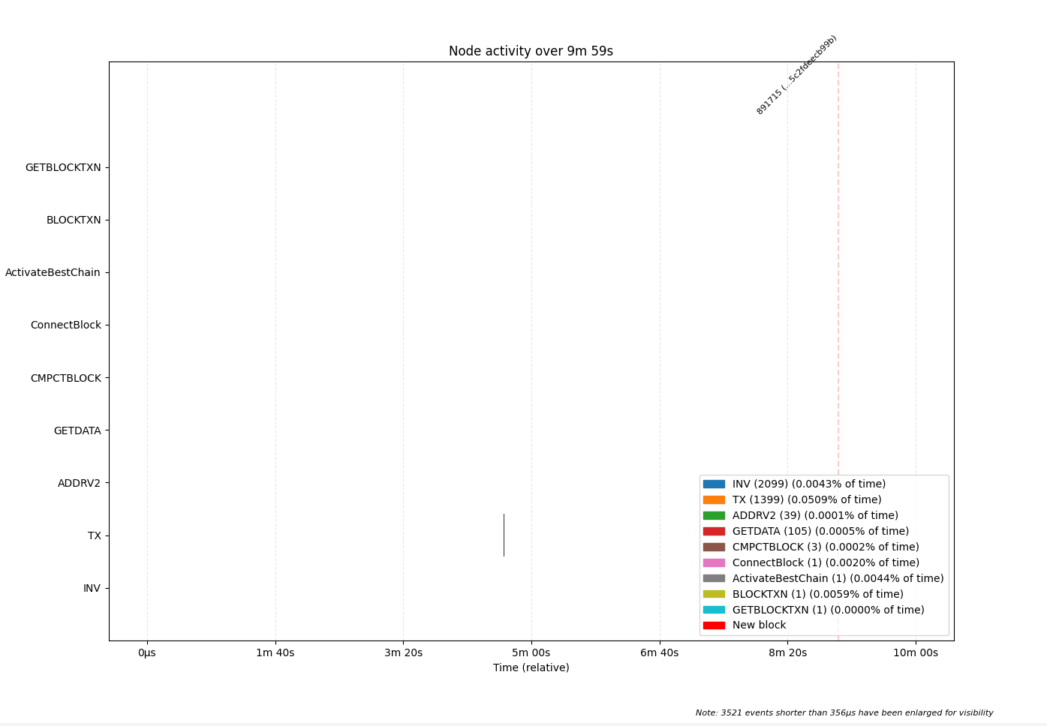
measurement: critical-path work timing

Slide 41

measurement: critical-path work timing

Slide 42
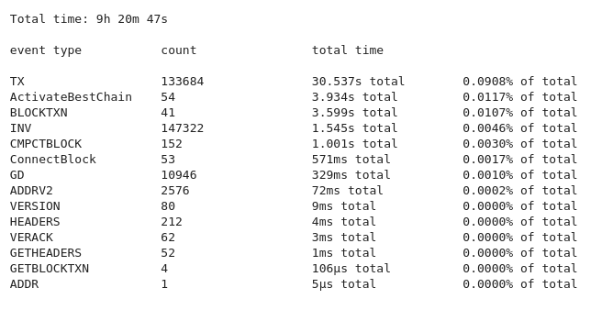
measurement: critical-path work timing

Slide 43
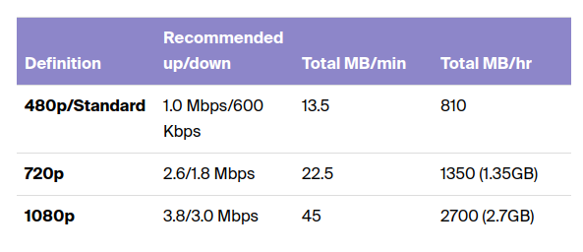
bandwidth required

Slide 44
mempool diffs
“too much in the mempool; upon new block I’ll have to retrieve too much”

Slide 45
miner centralization
block propagation

Slide 46
miner centralization
selfish mining

Slide 47
measurements

Slide 48
actual problems

Slide 49
UTXO set indexing/size
utreexo fixes this at the cost of ~2x bandwidth
but maybe doesn’t even matter that much since UTXO retrieval is distributed throughout poisson interval

Slide 50
mitigations

Slide 51
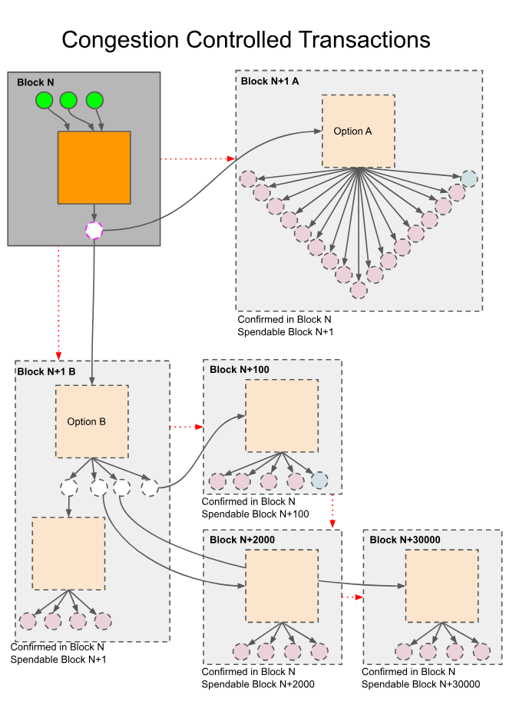
design
for exit
utxos.org

Slide 52


Slide 53
Have our trade-offs
aged well?

